Slide 1
MANAGE YOUR MEMBERSHIP
View membership details, set renewal preferences, print membership card, update contact information, manage subscriptions and view purchase history.
July 2024
Notes:
MyLegion is a secure website for American Legion and Sons of the American Legion members. View and manage membership information through MyLegion.org.

Slide 2
ABOUT MYLEGION
Member online access to LGN and SAL membership details, discounts, renewal options, online subscriptions, and access to print a current card.
Displays and updates information on file at department and national headquarters.
Notes:
MyLegion provides access to both The American Legion and Sons of the American Legion membership details, discounts, renewal options, online subscriptions, and access to print a current membership card.
<1> Information in MyLegion displays what is on file at your department and national headquarters.

Slide 3
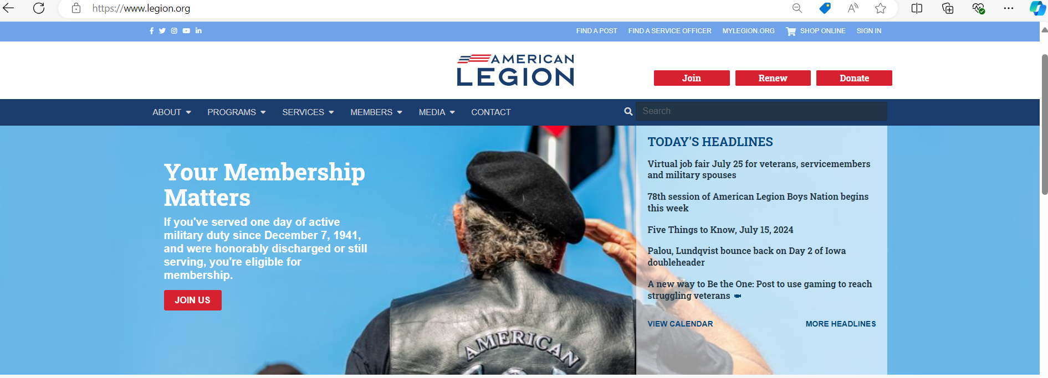
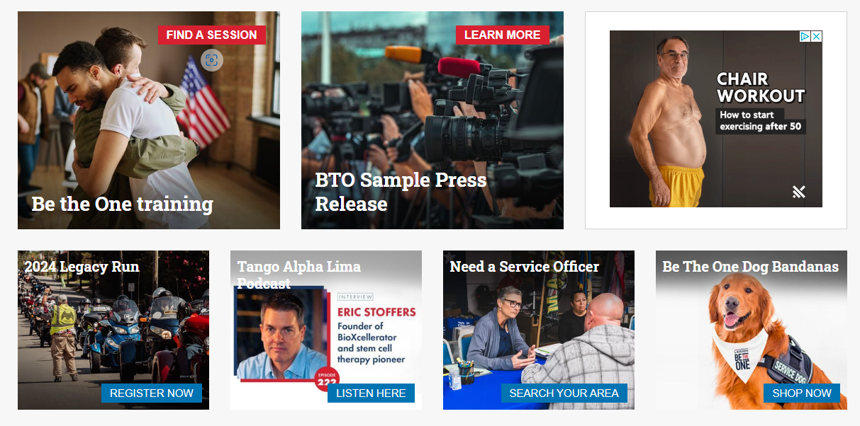
LEGION.ORG
National HQ public website
Department contact information
American Legion programs and services
Notes:
Access myLegion through The American Legion National website legion.org. Legion.org is a public site that provides contact information, American Legion available programs, services, and publications for The American Legion American Legion and The American Legion family.
<1> Located at the top of the page is a link for MyLegion.

Slide 4
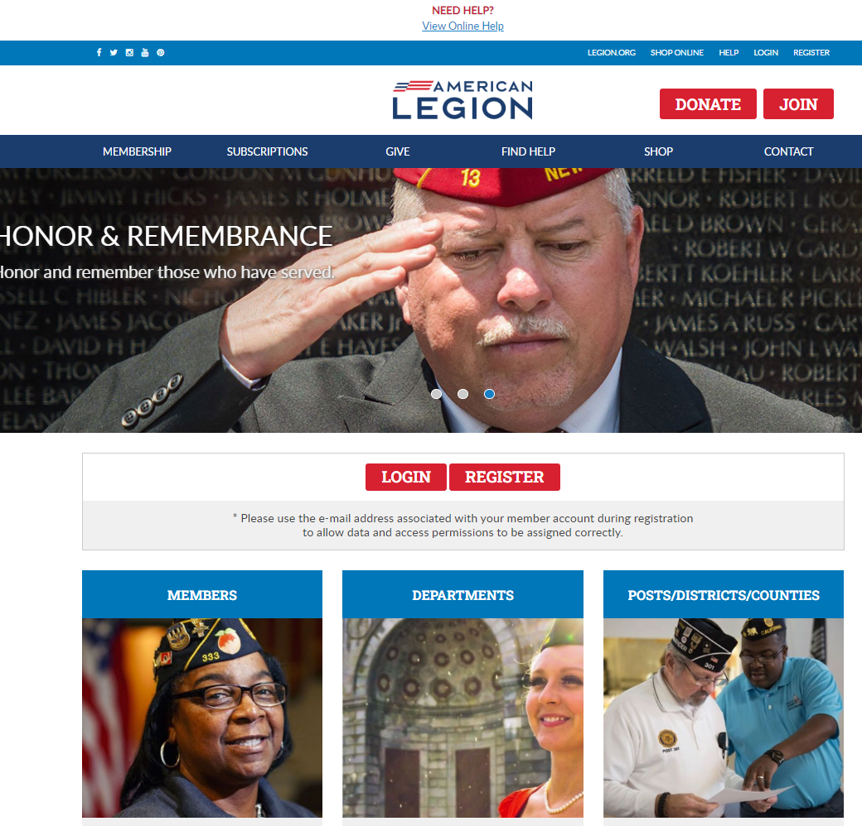
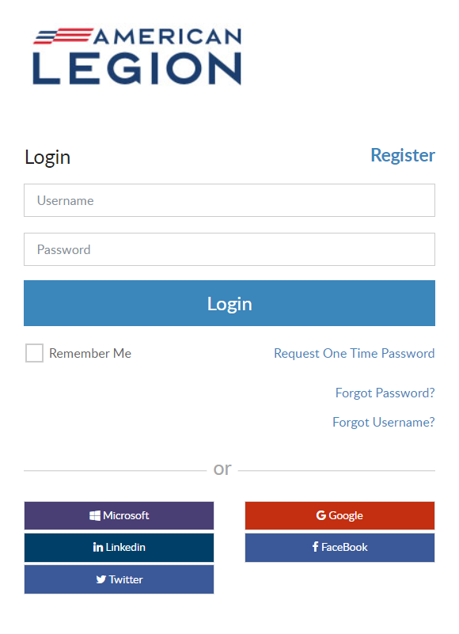
MYLEGION.ORG
Notes:
Log In at the upper right corner or using the login button. If you don’t have an account, click register to create one using the email address on your membership record.

Slide 5
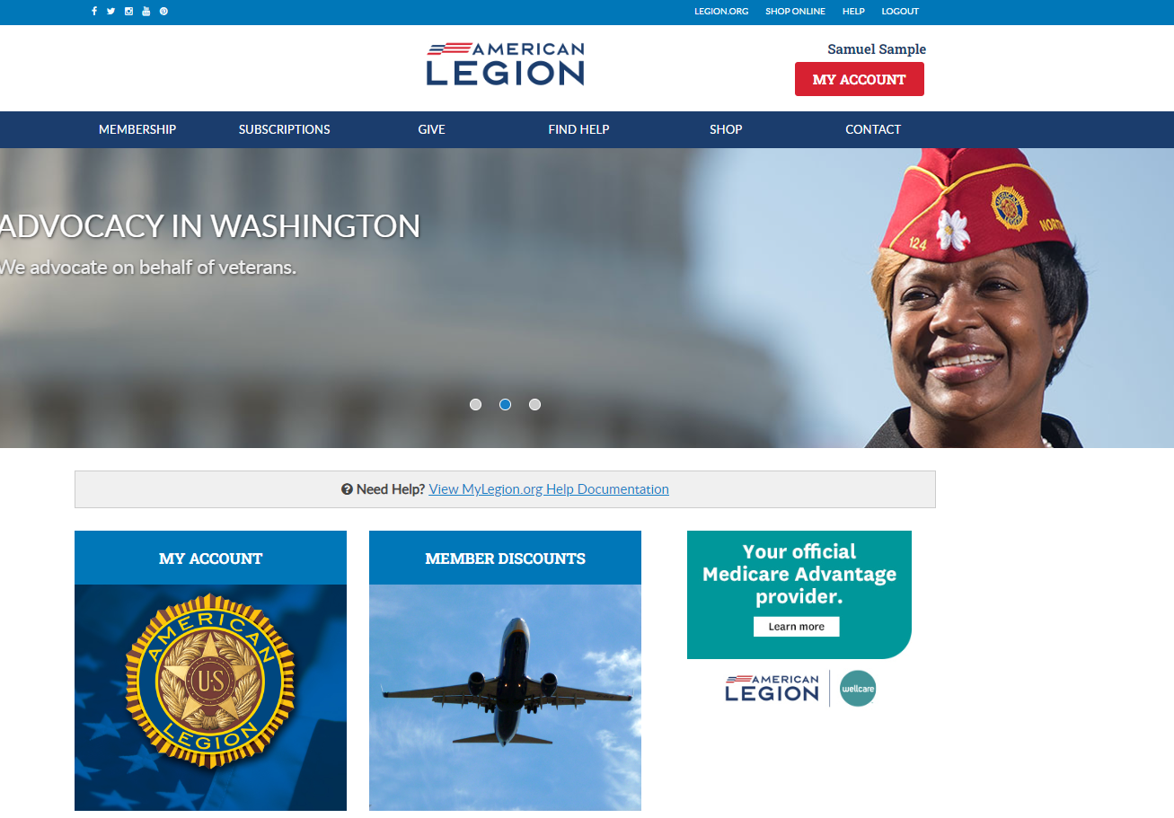
MYLEGION HOME
Links to Legion.org
Find Help
Notes:
Logging into MyLegion opens a Home page that identifies the member’s name located above the MY ACCOUNT button. <1>

Slide 6
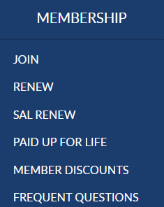
MEMBERSHIP
Join
Renew
Paid Up for Life
Member Discounts
Frequent Questions
Notes:
MyLegion provides links to Legion.org. Some links require a log in to access.
Membership links include Join options, Online Renewal, Paid Up for Life information, member discounts, and frequently asked questions about membership eligibility.

Slide 7
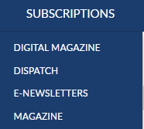
SUBSCRIPTIONS
Digital Magazine
Dispatch
E-Newsletters
Magazine
Notes:
Membership in The American Legion includes The American Legion Magazine in digital format from the Subscriptions menu, a link to monthly Dispatch articles and set up options for online E-Newsletters. The Magazine option at the bottom of the list provides a link for non-members to purchase and renew their subscription or purchase additional subscriptions.

Slide 8
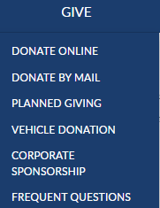
GIVING OPPORTUNITIES
Donate online or by mail
Planned giving
Vehicle donation
Corporate sponsorship
Frequent Questions about giving
Notes:
Online giving opportunities can be set up through a MyLegion account. The give menu provides information for planned giving, vehicle donations and corporate sponsorships. Questions about giving to American Legion charities are answered in frequent questions.

Slide 9
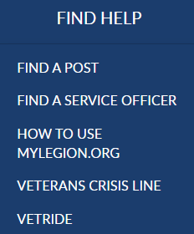
FIND HELP
Find a Post
Find a Service Officer
How to Use MyLegion
Veterans Crisis Line
Vet Ride
Notes:
Find Help provides contact information for accredited service officers with step-by-step help documentation to assist with MyLegion tools for members and leadership. Links to veteran’s crisis line and Vet Ride are also available.

Slide 10
SHOP / CONTACT
National Emblem Sales
National HQ Contacts
My Account
Notes:
The Shop link navigates to National Emblem Sales, and <1> Contact re-directs to legion.org’s National HQ directory.
To view membership details and manage your account click on My Account.
Leadership seeking post and squadron membership will access that information through My Account.

Slide 11
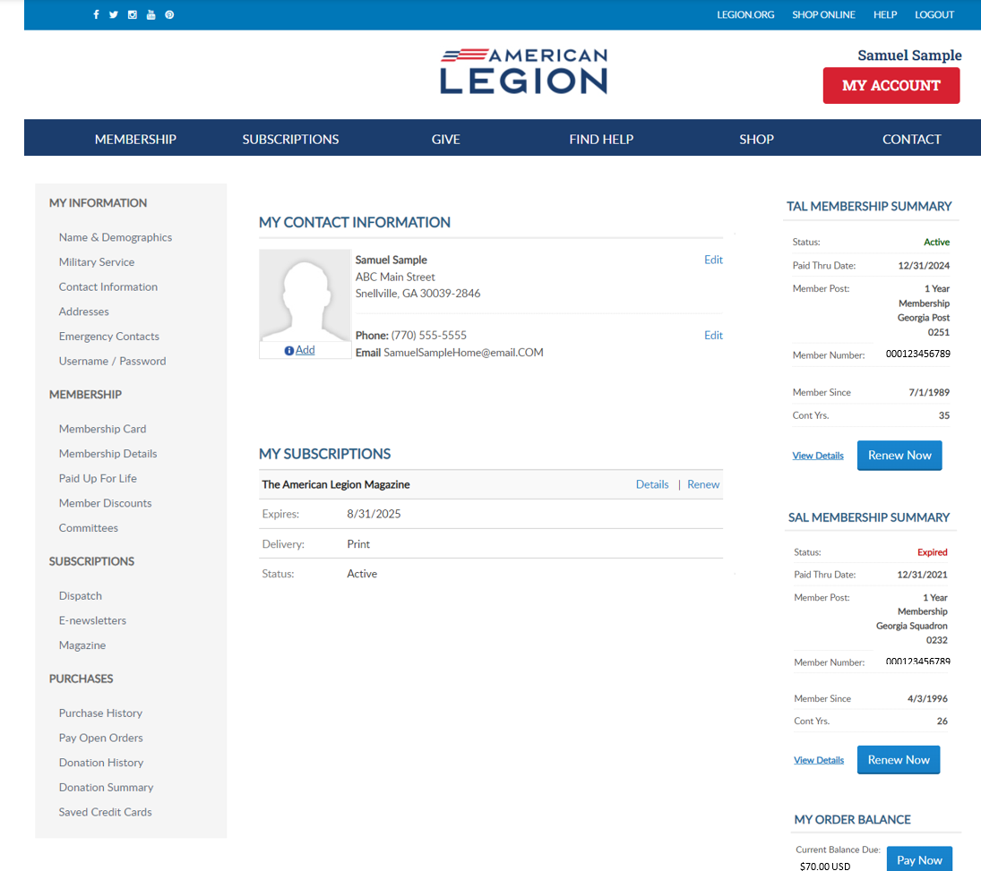
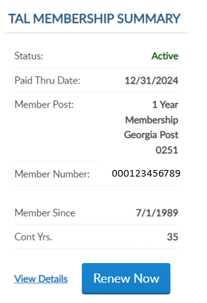
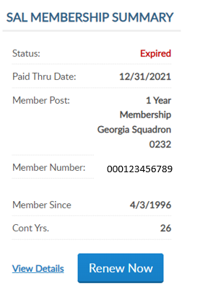
MY ACCOUNT
My Information
Membership Summaries
LGN SAL
Notes:
My Account provides membership information on file at national headquarters. Use the menu options to manage your membership.
<1>Summaries for American Legion and Sons of the American Legion membership include member status, renewal status, post and squadron number, member ID, join date and continuous years. When a renewal is available the renew now button will display. To renew, click the renew now button.
Members of both The American Legion and SAL are known as dual members and will have the same membership ID#.

Slide 12
NAME & DEMOGRAPHICS
Click “Edit” to update.
Notes:
MyLegion allows you to manage your name and demographic information. From the left menu, select Name & Demographics to open the edit window. <1>
There are 2 sections in this area. Each has an Edit option. The name section includes prefixes, suffixes, nickname and title information. Click edit to make updates.

Slide 13
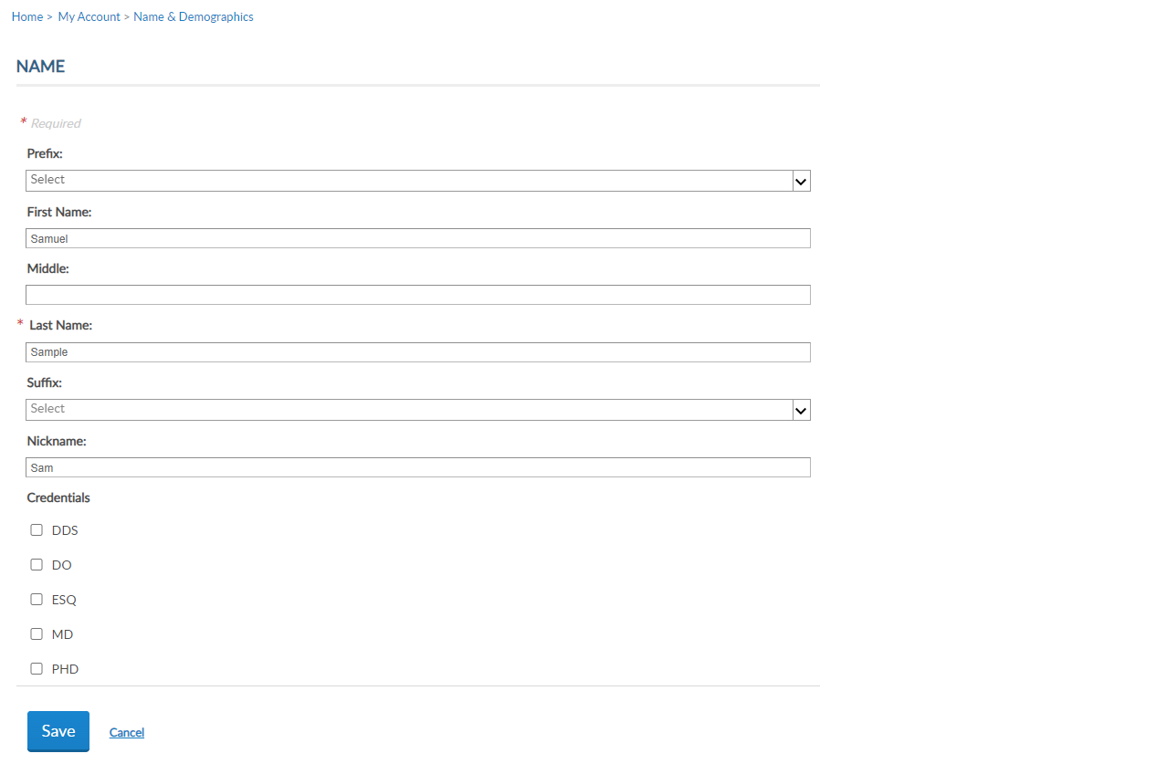
NAME
Enter updates and save.
Notes:
Drop down menus will display available prefixes and suffixes. Click Save once the updates have been made. <1>

Slide 14
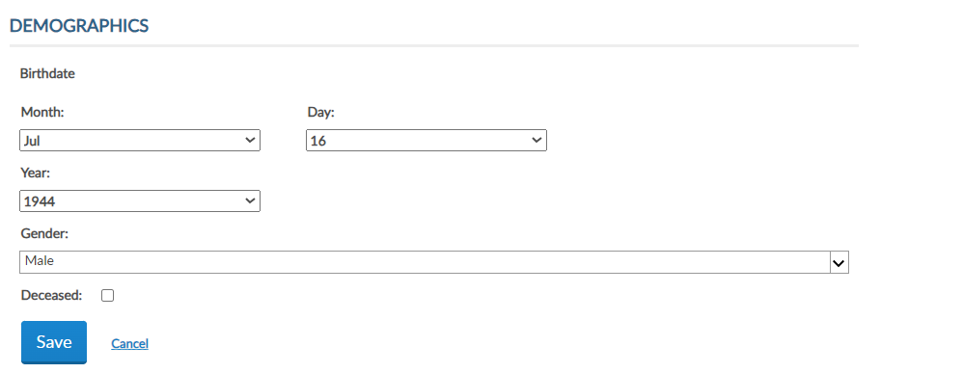
DEMOGRAPHICS
Date of Birth
Gender
Deceased Status
Enter updates and save.
Notes:
The demographics section includes date of birth, gender and deceased status. Click Edit <1> to make updates to demographics. Update as needed and Save. <2>

Slide 15
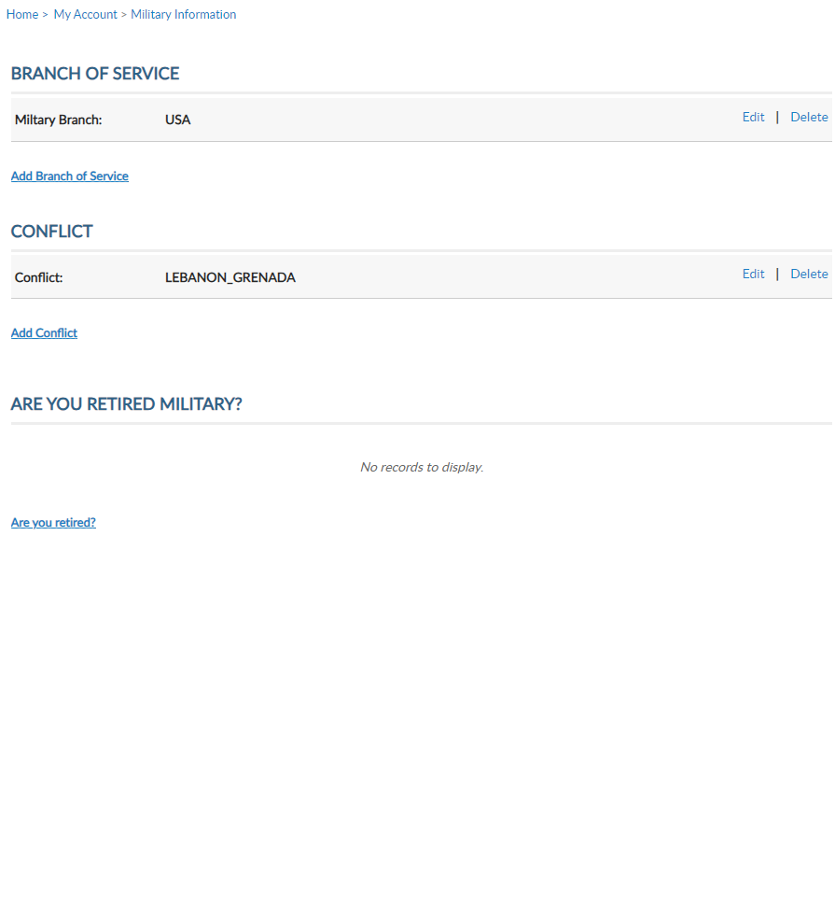
MILITARY SERVICE
Branch of Service
Conflict
Are you Retired?
Notes:
Military service provides branch of service, conflict and retirement information. Using the Add, Edit or Delete links you can manage this information. Members who have served in multiple conflicts or armed forces can add to their profile using Add links.

Slide 16
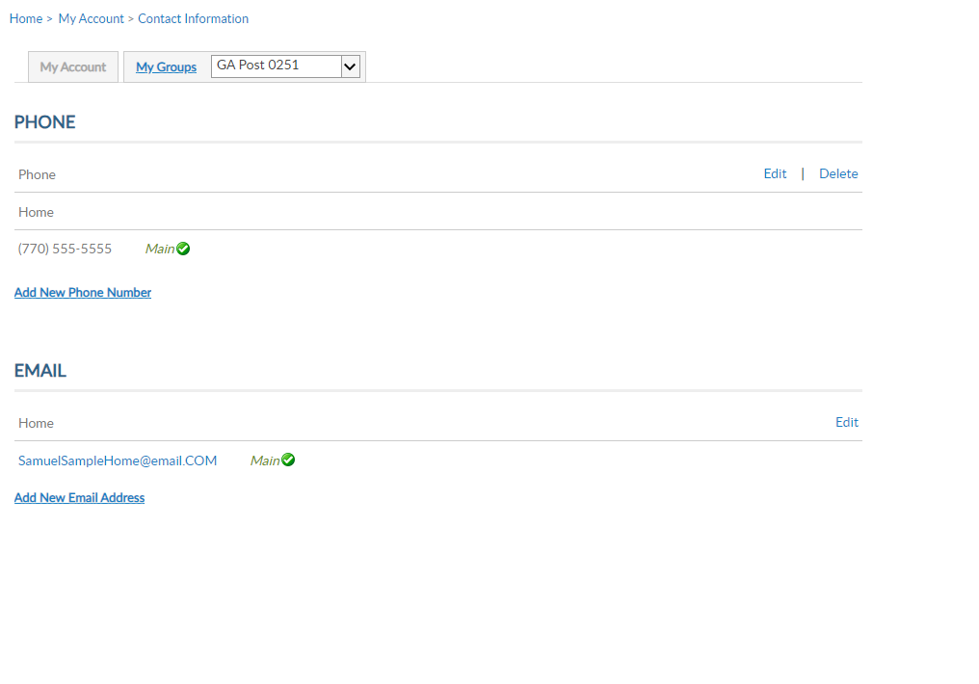
CONTACT INFORMATION
My Contact Information
Phone
Email Address
Notes:
Contact information includes phone number and email. Only one main address and email is available. You can edit address and phone number in My Contact Information.
<1> Using the left menu, you can have alternate phone numbers and email address on your membership record. These can be used for online subscriptions and committee assignments. Main contact information is listed on the post or squadron membership roster.

Slide 17
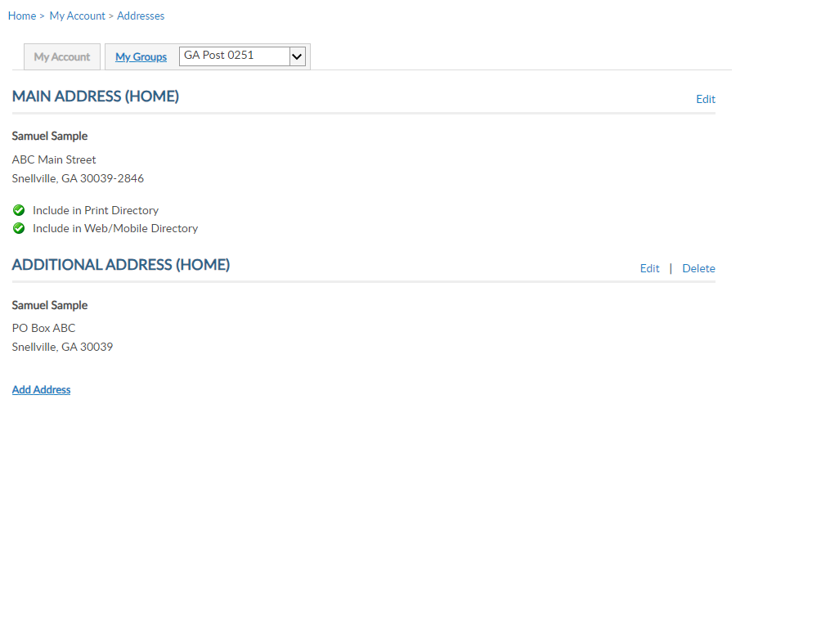
ADDRESSES
Main Address
Alternate Address
Notes:
Addresses allows you to add an alternate address and set address preferences. Information set as Main is the primary contact information.
Only one main contact can be on file. Adding an address with the Main Address preference will replace the existing main address.

Slide 18
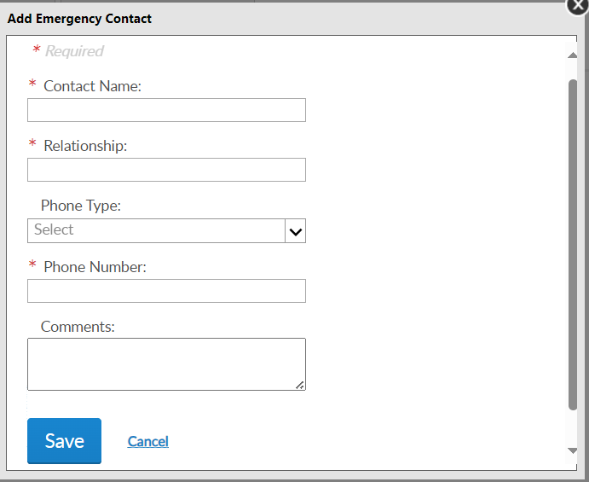
EMERGENCY CONTACTS
Add an emergency contact to your membership record that can be seen by local, department, and national leadership.
Notes:
Emergency contact information. This information can be useful in case of an emergency if you are attending a convention, event, or at your local post.
Add a single contact or multiple contact and designate the priority of who to contact via phone. <1> Click “Add New Emergency Contact”, enter data and “Save.”

Slide 19
USERNAME & PASSWORD
Manage username and password.
Notes:
Username/Password allows users to update log in credentials. This link opens a self-service window that shows your current username and primary email associated with your account.

Slide 20
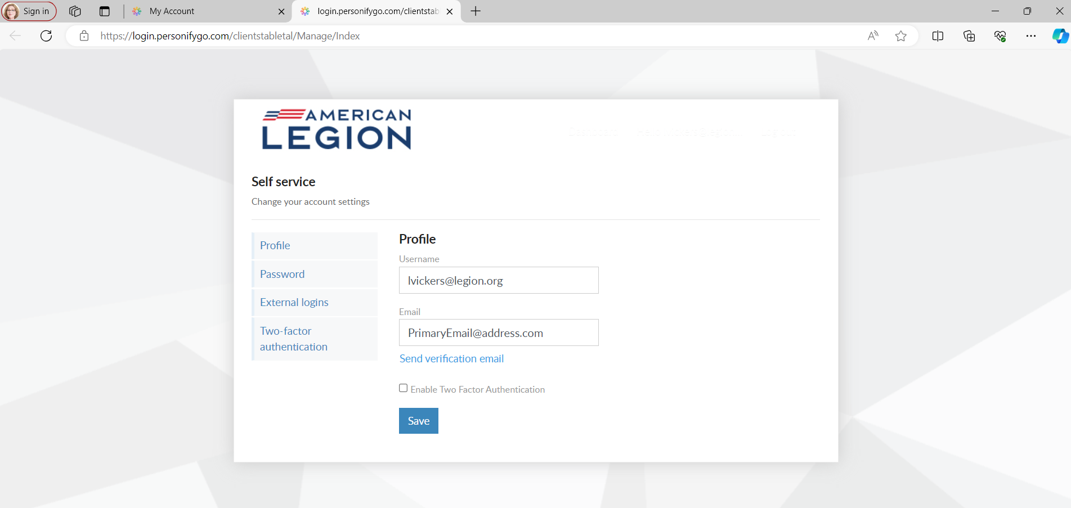
PROFILE
Notes:
Notice a new tab opens in your browser. When complete with reviewing or updating information, close the tab to return to your MyLegion account.
Your account profile includes username and primary email address. MyLegion accounts are associated with the primary email address on file. Your username does not have to be an email address but is recommended. The email address listed in the self-service window is the primary email. Updating the email in Username/Password directs all future forgot username and passwords to this email.
Enter new information and Save.

Slide 21
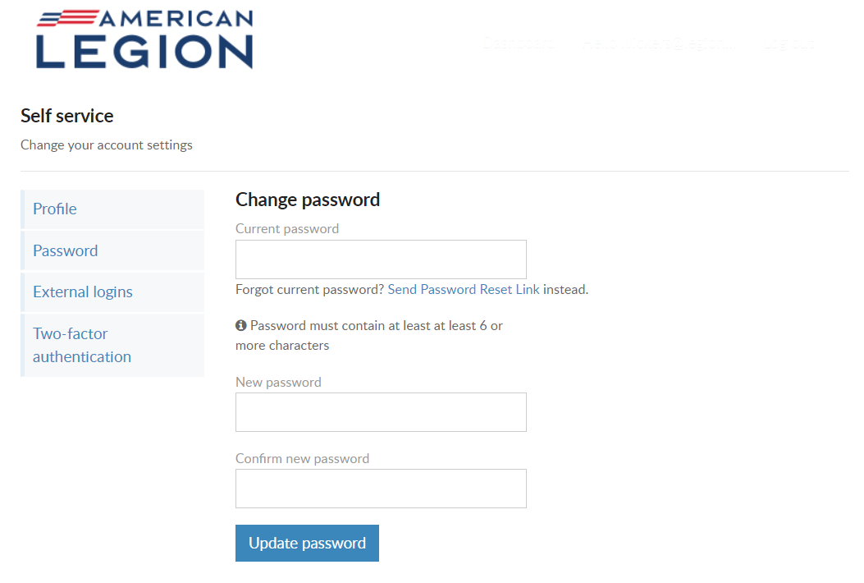
PASSWORD
Notes:
To update your password in the self-service window you must know your current password. If you have logged in with a saved password and do not know it, you can log out and use the forgot password link on the log in window.
If you have your current password, enter it with the new password and click ‘Update Password’.
<1> Password requirements include: 1 Uppercase letter, 1 Lowercase letter, 1 Number, 1 symbol, and have an eight character minimum.

Slide 22
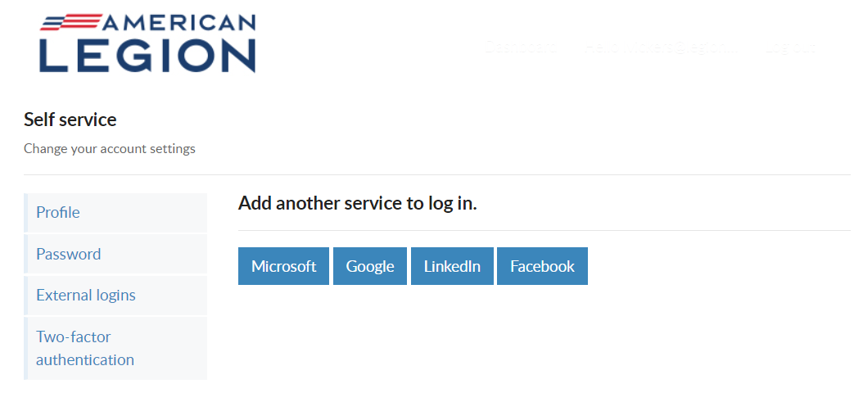
EXTERNAL LOGINS
Notes:
Like many other web applications, myLegion users can log in using other online identities as a single sign on process. Allowing fewer passwords to remember.

Slide 23
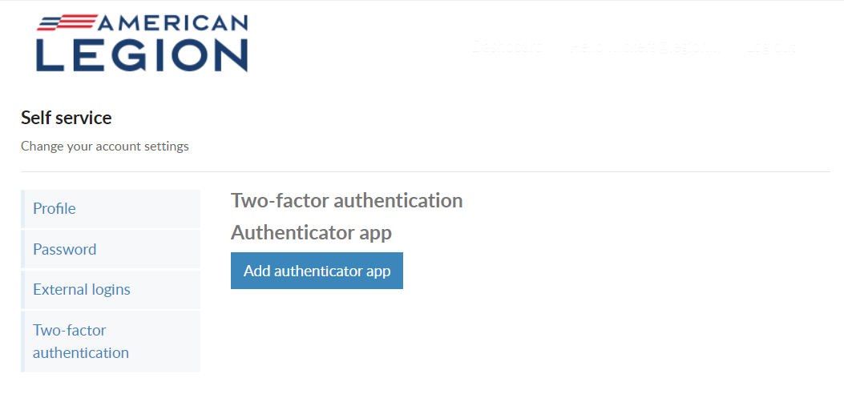
TWO-FACTOR AUTHENTICATION
Notes:
Two-factor authentication is an extra layer of security to ensure that you're the only person who can access your account, even if someone knows your password. This extra security measure requires you to verify your identity using a randomized code we'll send you each time you attempt to log in.
If you set up 2 factor authentication, you can disable through self service.

Slide 24
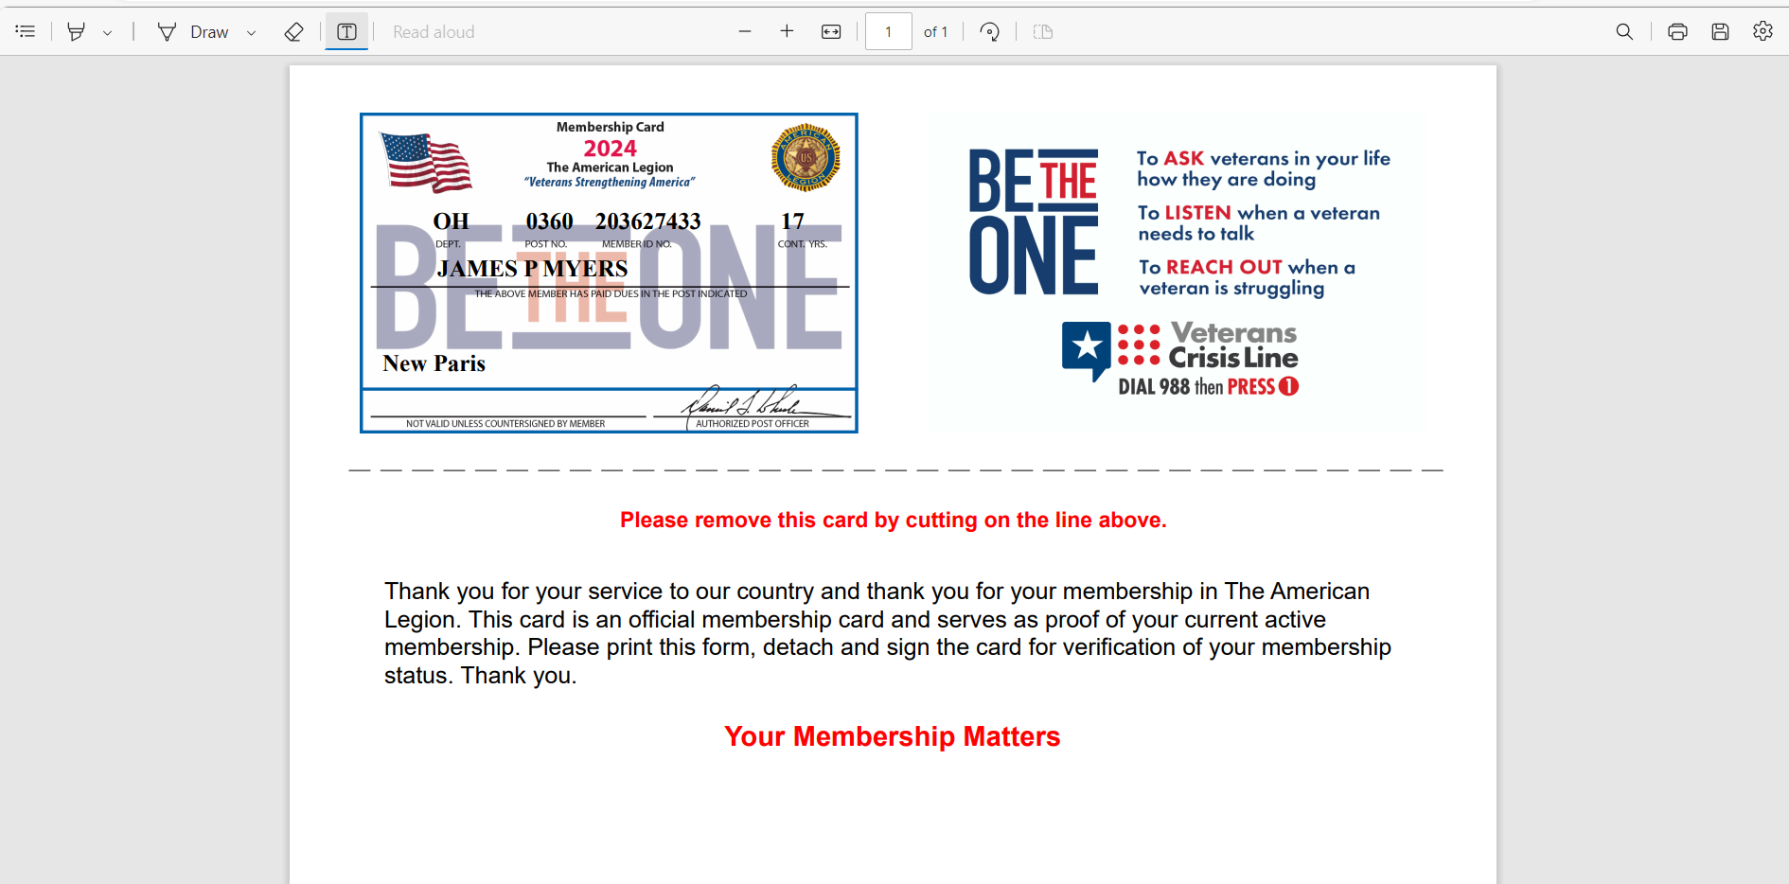
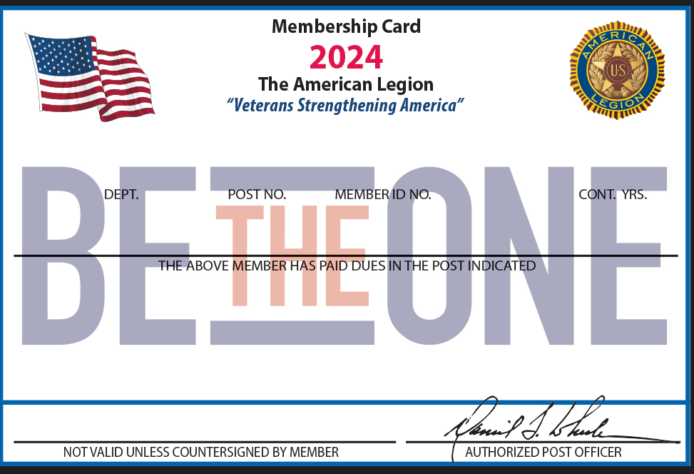
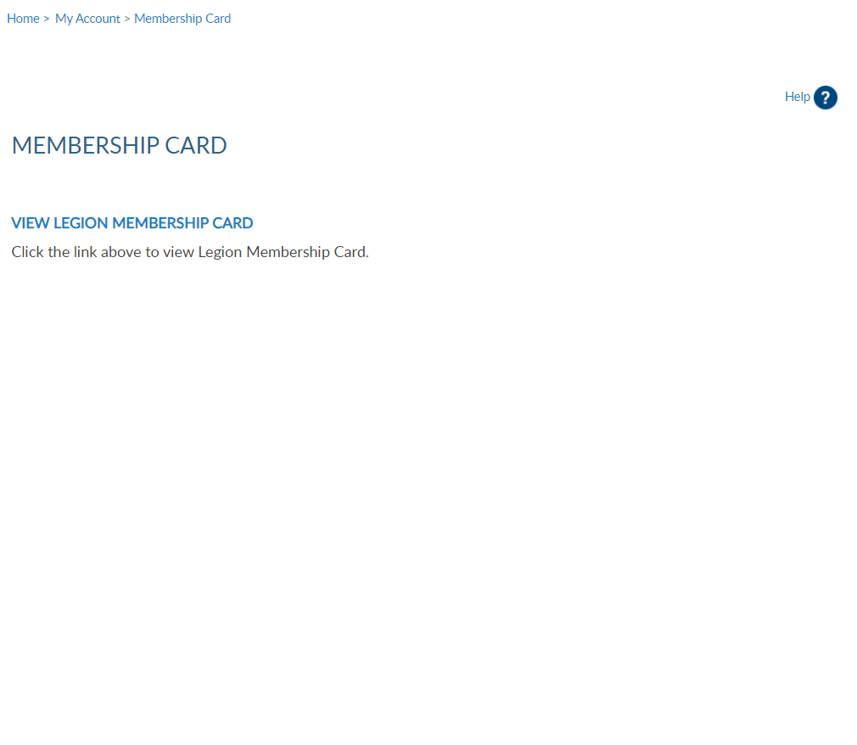
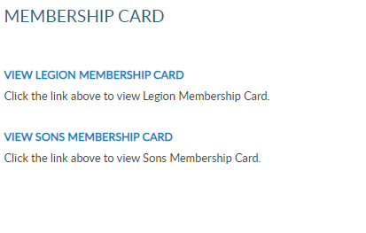
MEMBERSHIP CARDS
GA 0251 123456789 10
SAM SAMPLE
SAL Membership is expired. No card available to print.
Notes:
To print your membership card go to Membership Card. Only current membership cards are available. Click the link for the card to print.
The card is available to print or save from your web browser..

Slide 25
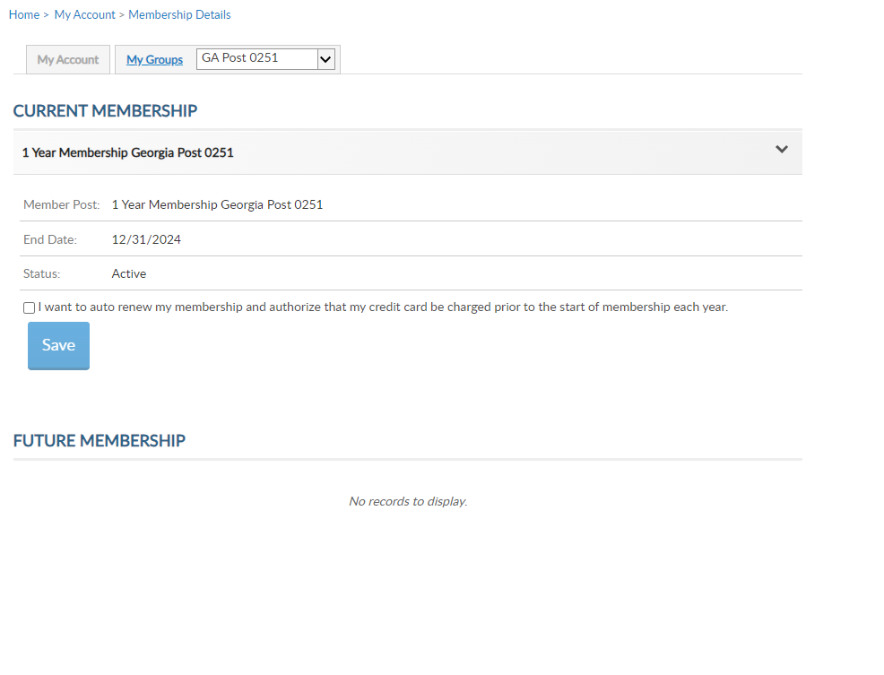
MEMBERSHIP DETAILS
Membership status and end date
Auto renew preferences
Notes:
View membership status and manage automated renewal in Membership Details.
MyLegion allows you to set up auto renewal. Members set up for auto renewal will have their credit cards charged by the 2nd week of July annually and do not receive renewal notices. Auto renew is available for both American Legion and Sons of the American Legion members. You will have to set up each auto renew separate if you are a dual member.
A credit card must be saved prior to setting up auto renew. Credit card information is stored in Saved Credit Cards. <1>

Slide 26
PAID UP FOR LIFE
Paid Up For Life Application
*DOB required
*Legion Only
Notes:
The Paid Up For Life links provide the application to purchase a paid up for life membership. The application provides a quote to purchase or set up a time payment plan.

Slide 27
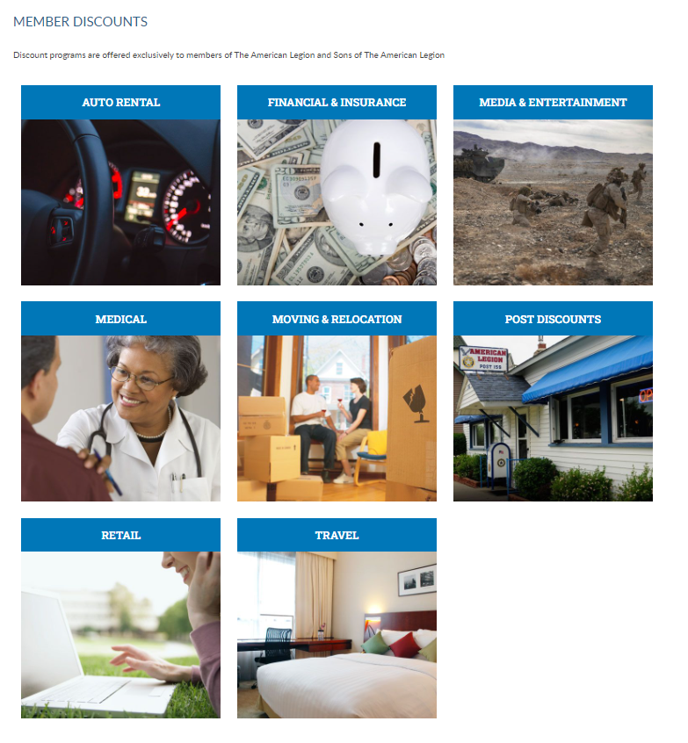
MEMBER DISCOUNTS
View provider contact information and discount codes.
Notes:
The American Legion offers exclusive discount programs for members of The American Legion and Sons of the American Legion. Discount provider information and codes are only available to members.
Discount codes are found only when logged into myLegion or legion.org. Select the area of interest to view provider contact information and exclusive discount codes.

Slide 28
COMMITTEES
Local, Department and National committees and commissions.
Past, Current, Future
Contact Department if officer information is incorrect.
Notes:
Committees list current, future and past positions reported to national headquarters. Missing information regarding your officer history can be clarified through your department headquarters.

Slide 29
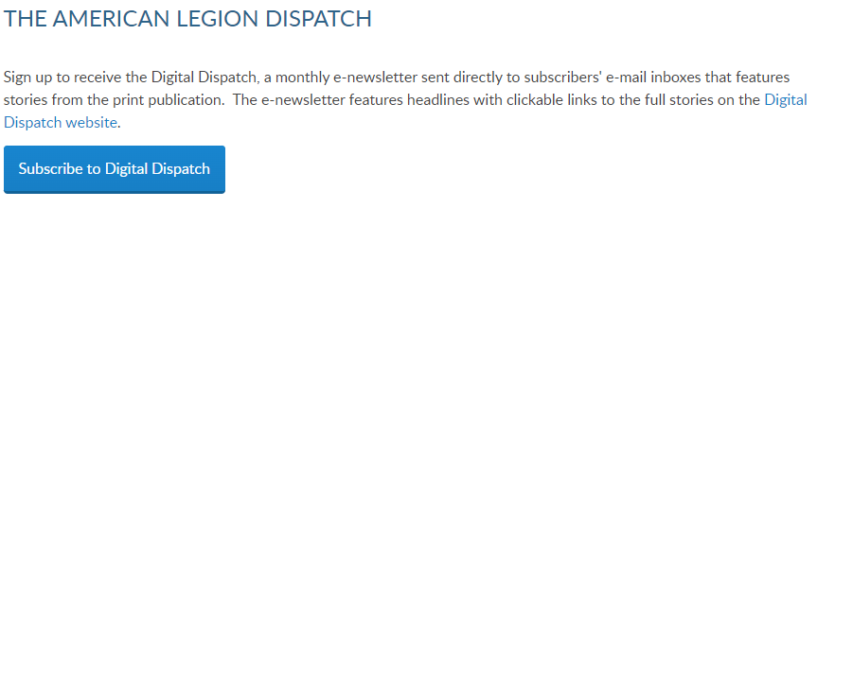
DISPATCH
Digital only
Notes:
Dispatch is an American Legion National Headquarters monthly online newsletter that provides post, district and department leaders with news relevant to membership, post activities and national American Legion news.
A monthly Digital Dispatch e-newsletter is sent directly to subscribers’ email inboxes. The e-newsletter features headlines with clickable links to the full stories on the Digital Dispatch web page, www.legion.org/dispatch.

Slide 30
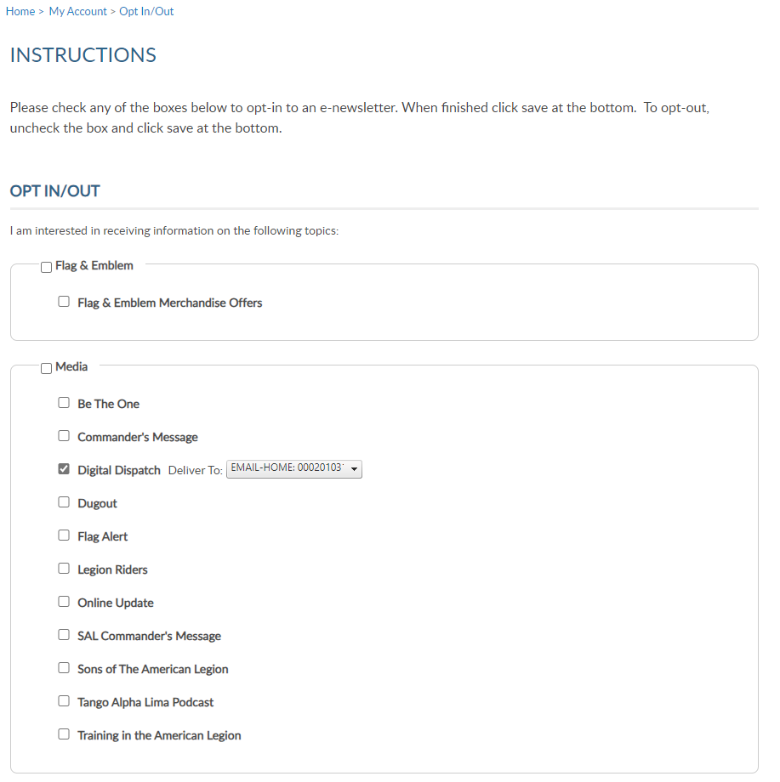
E-NEWSLETTERS
Opt in and out of national newsletters.
Notes:
E-newsletters allows you to opt in or out of online subscriptions.
Check the box to select individual subscriptions. Unless specified these subscriptions will be emailed to the main email address on file.
Once all options are selected, save changes.

Slide 31
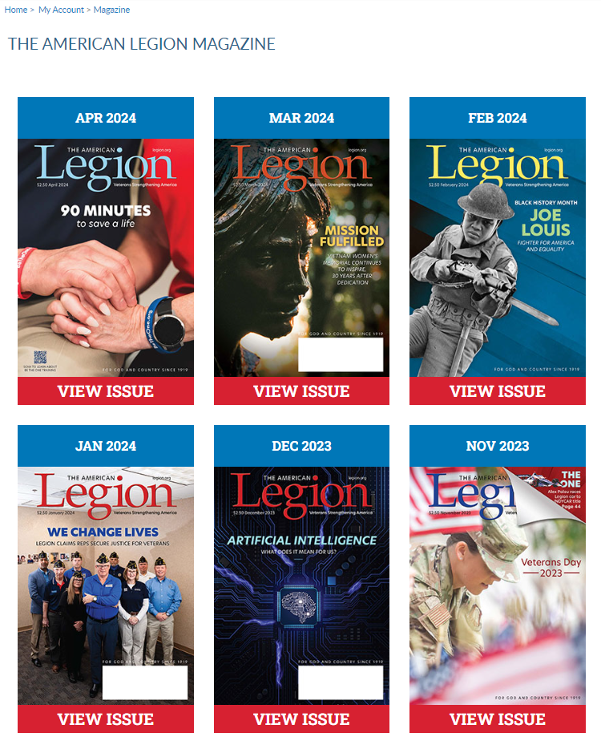
TAL MAGAZINE
12-month subscription included with membership.
Digital current and past issues.
Current members only.
Notes:
Members receive a 12-month free subscription to The American Legion Magazine. This publication has gone digital. Current and past issues are located your My Account subscriptions menu.
Expired members will receive an Access Denied message. Access to online magazine requires active American Legion, Sons of the American Legion membership, or paid subscription.

Slide 32
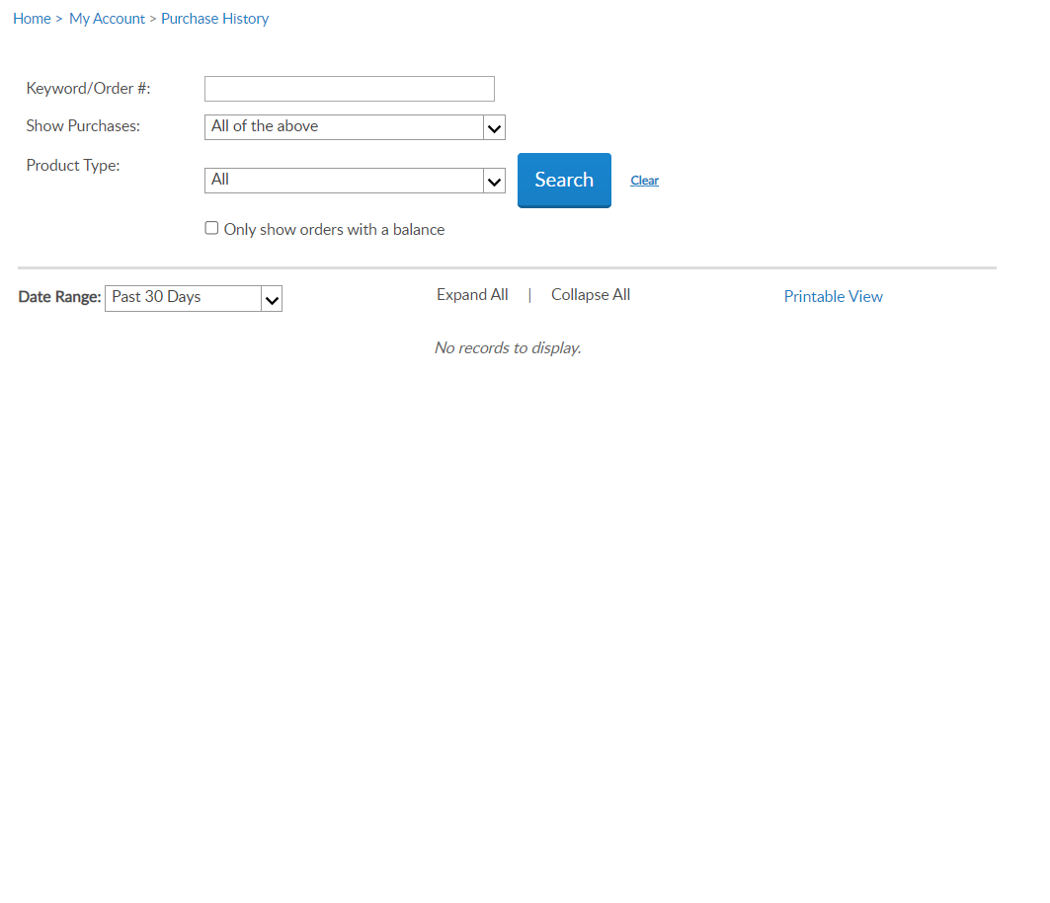
PURCHASES
Membership Dues
Pay Open Orders
Donation History
Donation Summary
Saved Credit Cards
Notes:
Purchase history shows history of payments made for membership, donations and subscriptions listing the amount and date. <1> Use date range to view membership payments. Credit card information can be stored for future renewals and donations. To add, remove or update credit card information to go Saved Credit Cards.

Slide 33
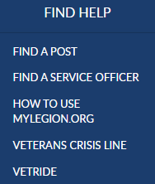
MY ACCOUNT & HELP RESOURCES
Notes:
Learn more about MyLegion using “Find Help” and go to How to use MyLegion.org.

Slide 34
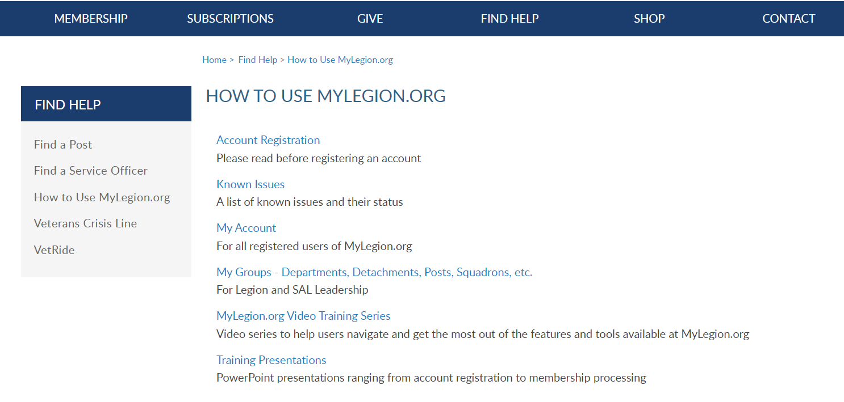
Online Help
Notes:
Step by step instructions, videos and training presentations will assist with how to manage your member account and groups in MyLegion.

Slide 35
Contact your department or national MyLegion support to assist with any questions or help with MyLegion.
MyLegion@legion.org
833.253.9995
Monday – Friday
8:00am – 4:30pm
(Eastern)
Notes:
Contact your department or national MyLegion support to assist with any questions help with MyLegion.

